Slide 1


MySQL Database for an Online Greeting Card Retailer: Project Overview
- Aimee Carter and Angharad James

Slide 2
Database
Sales
Customers
Balance
Design
Card Size
Card Occasion
Card Theme
Gift
Postage
Tables
AD Targeting
Card Sentiment
Daily Sales Report

Slide 3
Database
Design
EER Diagram

Slide 4
Text Here
Subquery

Slide 5
Text Here
Subquery

Slide 6
Text Here
View

Slide 7
Text Here
View

Slide 8
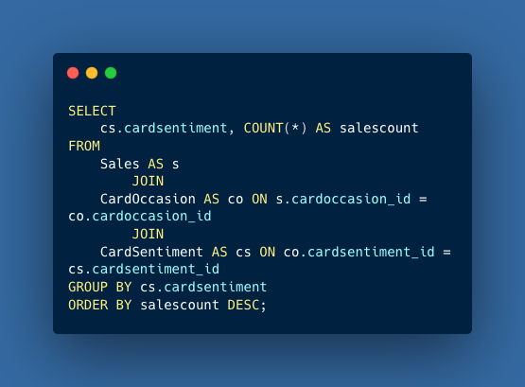
Which Sentiment Category Tops the Sales List, and What Occasion Is Behind Its Success?
Group By & Having
Querying the database to determine which sentiment category generates the highest sales count.

Slide 9
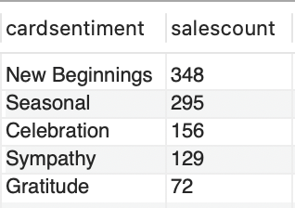
Which Sentiment Category Tops the Sales List, and What Occasion Is Behind Its Success?
Group By & Having
New Beginnings, cardsentiment_id 3, has the highest sales count.

Slide 10
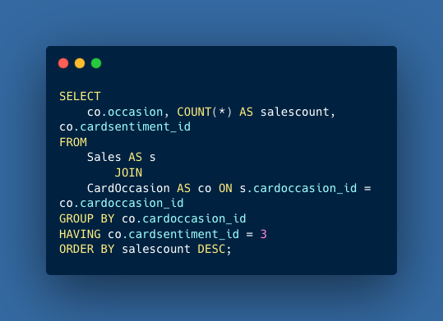
Which Sentiment Category Tops the Sales List, and What Occasion Is Behind Its Success?
Group By & Having
We can now use this analysis to further examine our occasions ranges to find the most frequent seller.

Slide 11
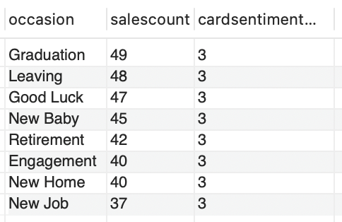
Which Sentiment Category Tops the Sales List, and What Occasion Is Behind Its Success?
Group By & Having
Graduation cards are our most frequent cards sold in our ‘New Beginnings’ range.

Slide 12
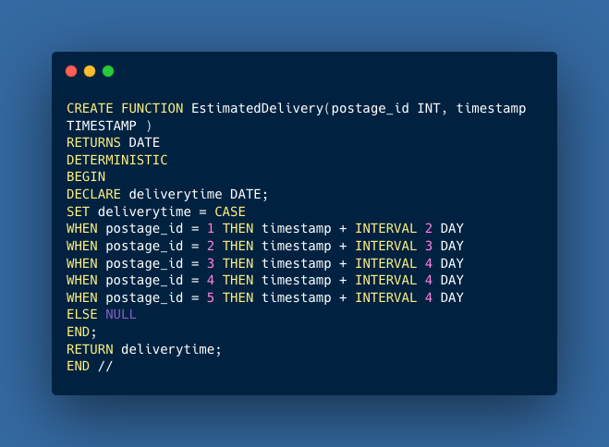
How Can We Refine Our Approach to Estimating Delivery Times?
Stored Function
This stored function provides an estimated delivery time for a customer’s order.

Slide 13
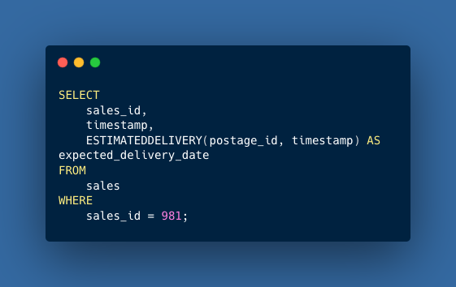
How Can We Refine Our Approach to Estimating Delivery Times?
Stored Function
A Customer with sales_id 981 has said their order has not arrived.

Slide 14
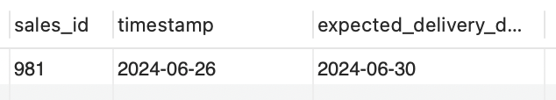
How Can We Refine Our Approach to Estimating Delivery Times?
Stored Function
As the delivery date has now far exceeded the expected delivery time, we should refund the customer and start a claim with our delivery provider.

Slide 15
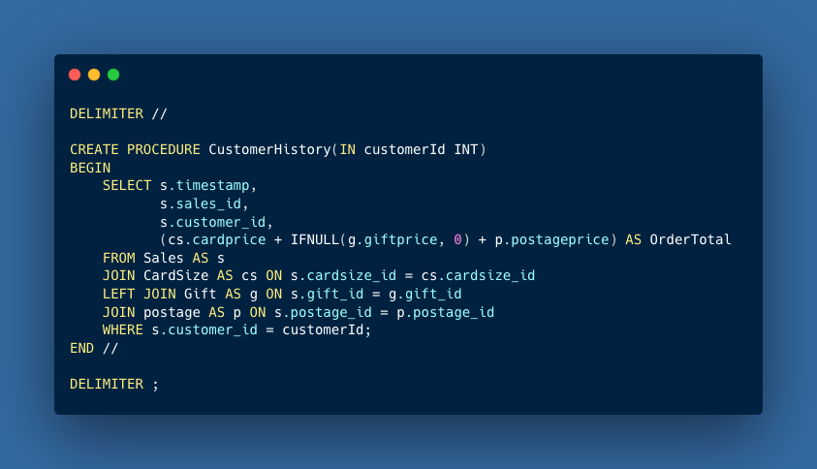
How Can We Efficiently Retrieve Customer Order History on Demand?
We can easily generate a report on a customer’s sales history with only their customer id.
Stored Procedure

Slide 16
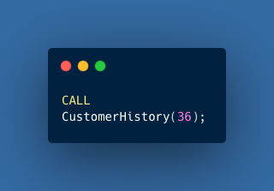
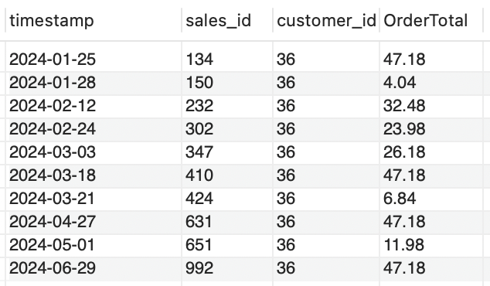
How Can We Efficiently Retrieve Customer Order History on Demand?
The order history of the customer with id 36 can be retrieved with this syntax
Stored Procedure

Slide 17
How Can We Standardize Customer Data Entry to Maintain Accuracy?
Trigger

Slide 18
How Can We Standardize Customer Data Entry to Maintain Accuracy?
Trigger

Slide 19
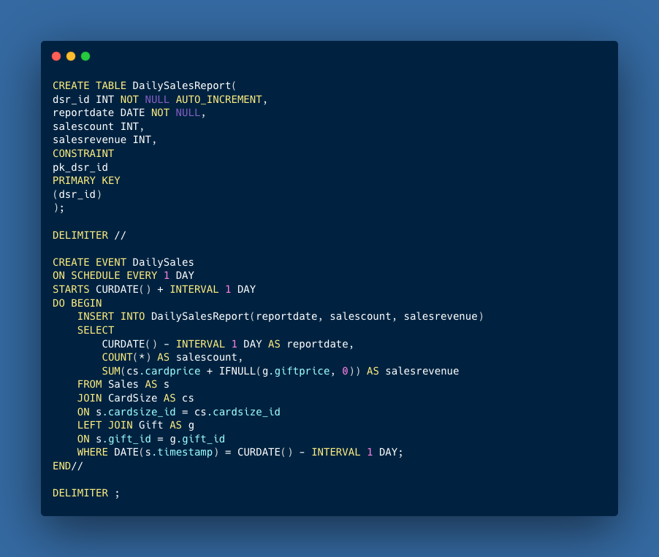
What Tools Can Help Us Automate the Daily Sales Report Generation?
We created a new table for the daily sales report. With this event scheduled, it will automatically generate our total revenue for the previous day.
Event

Slide 20
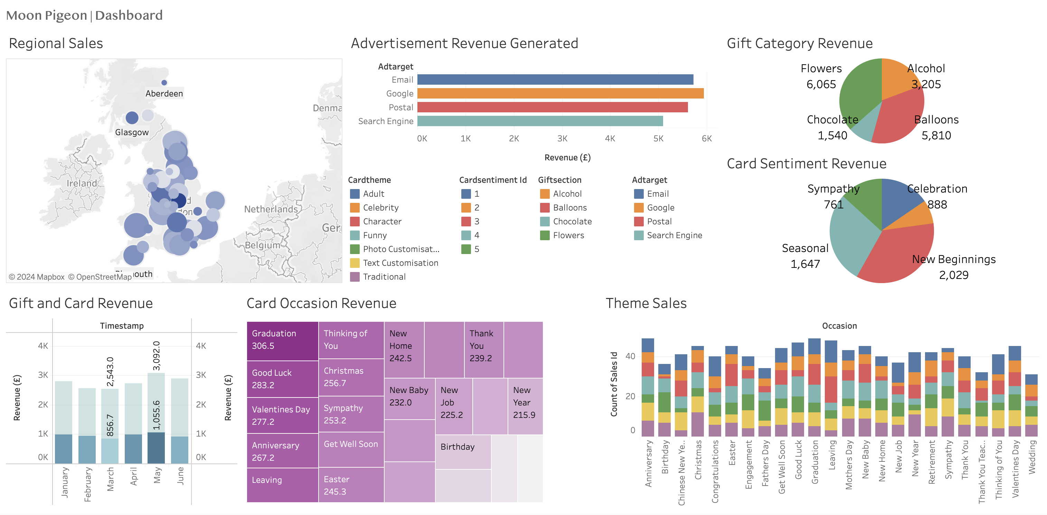
Tableau Sales Dashboard

